Slide 1
ASSEMBLY LANGUAGE PROGRAMMING
JIIT-128, Noida

Slide 2
Programming
87
1. Write an assembly program to add two numbers
MVI D, 02BH
MVI C, 06FH
MOV A, C
ADD D
STA 4500
HLT
JIIT-128, Noida

Slide 3
Program
88
Write an assembly program to add two numbers
LXI H, 4500
MOV A, M
INX H
ADD M
STA 4500
HLT
JIIT-128, Noida

Slide 4
Program
89
2. Write an Assembly Language Program to add two numbers ;
results contain carry
LXI H, 4500 MOV A, M INX H
ADD M
JNC LOOP 1 INR C
STA 4500
MOV A, C STA 4501 HLT
LOOP1
JIIT-128, Noida

Slide 5
Program
90
2. Write an Assembly Language Program to add two numbers ; results contain carry ( write the program using JC)
LXI H, 4500 MOV A, M INX H
ADD M
 | JC | LOOP 1
 | JMP | LOOP 2
LOOP1 | INR C
STA 4500 MOV A, C STA 4501 HLT
LOOP1
JIIT-128, Noida

Slide 6
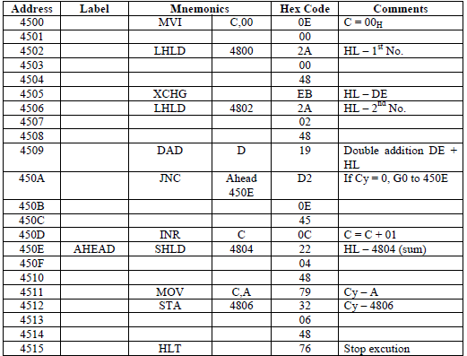
ADDITION OF TWO 16 – BIT NUMBERS
3. To write an assembly language program for adding two 16
bit numbers using 8085 micro processor.
91
JIIT-128, Noida

Slide 7
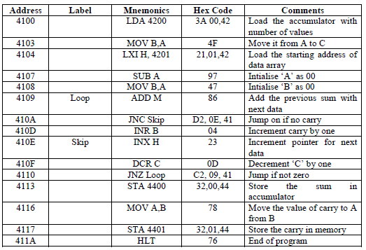
SUM OF DATAS
4. To write an assembly language program to
calculate the sum of datas using 8085 microprocessor
92
JIIT-128, Noida

Slide 8
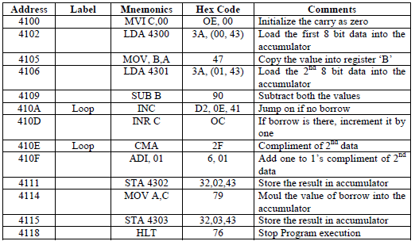
SUBTRACTION OF TWO 8 BIT NUMBERS
5. To write a assembly language program for subtracting 2 bit
93
(8) numbers by using- 8085
JIIT-128, Noida

Slide 9
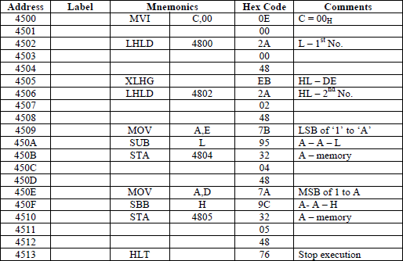
SUBTRACTION OF TWO 16 BIT NUMBERS
6. To write an assembly language program for subtracting two
94
16 bit numbers using 8085 microprocessor kit.
JIIT-128, Noida

Slide 10
Multiplication ; No carry
95
LDA 2000 // Load multiplicant to accumulator
MOV B,A // Move multiplicant from A(acc) to B register
LDA 2001 // Load multiplier to accumulator
MOV C,A // Move multiplier from A to C
MVI A,00 // Load immediate value 00 to a
L: ADD B // Add B(multiplier) with A
DCR C // Decrement C, it act as a counter
JNZ L // Jump to L if C reaches 0
STA 2010 // Store result in to memory
HLT // End
JIIT-128, Noida

Slide 11
Multiplication ; With carry
96
7. Write an assembly program to multiply a number by 8
MVI C,OO LXI H, 4100 MOV B, M INX H MOV A, M DCR B
LOOP 2 ADD M
JNC
INR C LOOP 1 DCR B
JNZ
LOOP1
LOOP2
STA 4500
HLT
JIIT-128, Noida

Slide 12
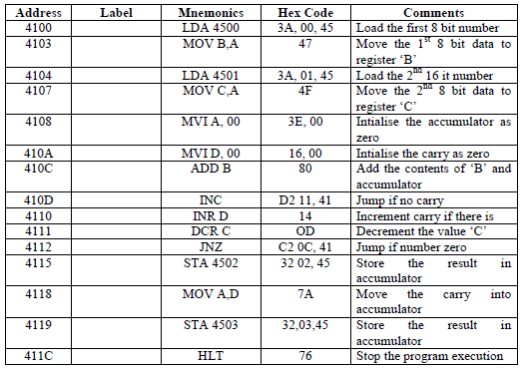
Multiplication
97
JIIT-128, Noida

Slide 13
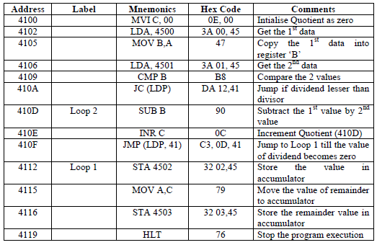
DIVISION OF TWO 8 – BIT NUMBERS
To write an assembly language program for
98
dividing two 8 bit numbers using microprocessor
JIIT-128, Noida

Slide 14
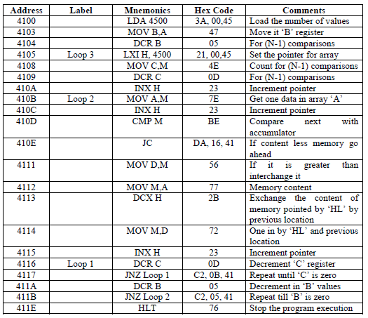
ASCENDING ORDER
9. To write a program to sort given ‘n’ numbers in
99
ascending order
JIIT-128, Noida

Slide 15
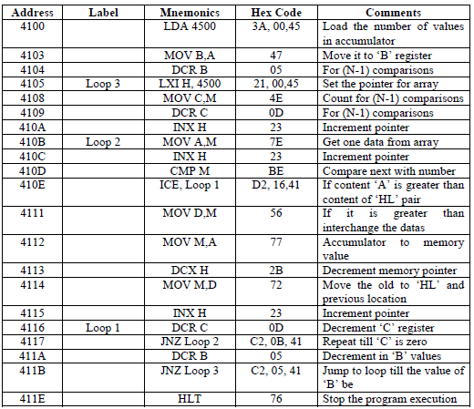
DESCENDING ORDER
10. To write a program to sort given ‘n’ numbers
100
in descending order
JIIT-128, Noida

Slide 16
Largest Number
101
Write an Assembly Language Program to find a largest number.
LXI H, 4500 MOV A, M INX H CMP M
JNC JMP
LOOP 1
LOOP 2
LOOP1 LOOP2
STA 4500 MOV A, M STA 4500 HLT
JIIT-128, Noida

Slide 17
Smallest Number
102
Write an Assembly Language Program to find a smallest number.
LXI H, 4500 MOV A, M INX H CMP M
JC LOOP 1
JMP LOOP 2
LOOP1 LOOP2
STA 4500 MOV A, M STA 4500 HLT
JIIT-128, Noida

Slide 18
References
Gaonkar, R. S. (1990). Microprocessor Architecture, Programming and Applications with the 8085. Fifth Edition Prentice Hall PTR.

